Slide 1
Investigating the mechanism of selective microRNA export via extracellular vesicles

Slide 2
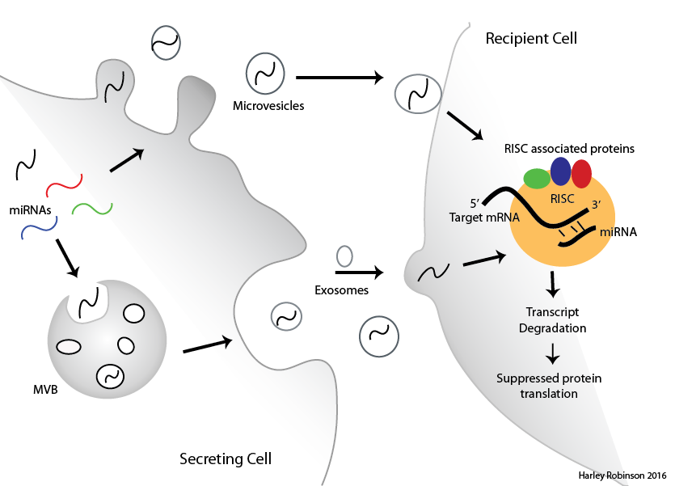
MicroRNAs in Extracellular Vesicles
EVs transfer cellular material between cells
MicroRNAs regulate RNA degradation
Sorting of microRNAs to EVs evident but mechanism not known

Slide 3
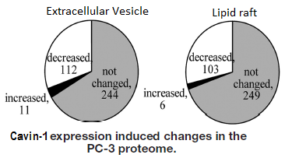
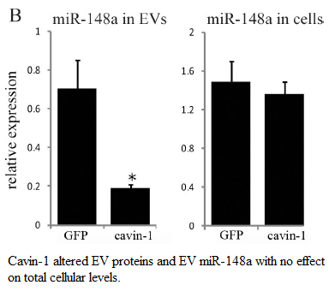
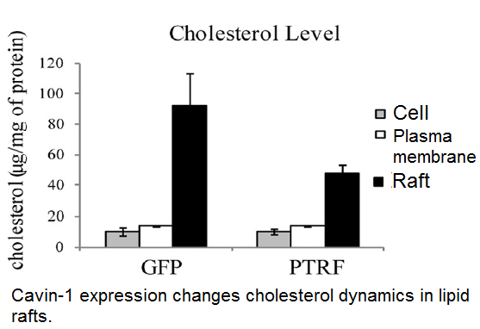
PC3 cell line.
Caveolin-1 expression: No Cavin-1 expression.
Addition of cavin-1 to these cells attenuates:
Oncogenic behaviour
Cholesterol re-distribution
MicroRNA EV content.

Slide 4
Aims and Hypotheses:
Hypothesis: miRNAs are selectively exported via extracellular vesicles indirectly moderated by cavin-1 in the PC3 model by mediating miRNA escort proteins in the EVs.
Identify the selectively exported miRNAs.
Identify candidate miRNA escort proteins.
Verify candidate miRNA escort proteins ability to bind to miRNAs and transport to extracellular vesicles.

Slide 5
Selectively Exported MiRs.
RNA-seq for small RNAs by Illumina in triplicate for GFP and cavin-1 cell lines AND in exosome and cell.
Analysis by R package: DESeq2
Filter, normalise, compare between cell lines then between cellular localisation.
9 miRs of interest (Labelled)

Slide 6
Selectively Exported MiRs.
Extract RNA from exosomes and cell (exoRNeasy and Mirvana Kits)
Normalized to miR-125a-3p
ddCT
MiR targets for pull down and validation of mechanism

Slide 7
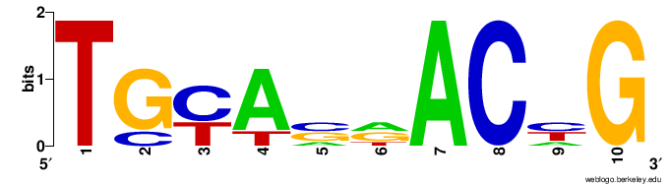
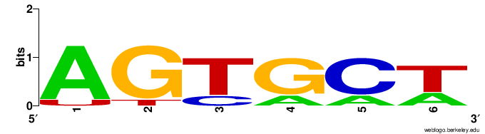
RNA-binding proteins and Motifs.
TAMO software suite: combines several different algorithms to identify motifs, evaluate enrichment and map motifs to sequences.
RBPdb: YBX1 and SNRPA

Slide 8
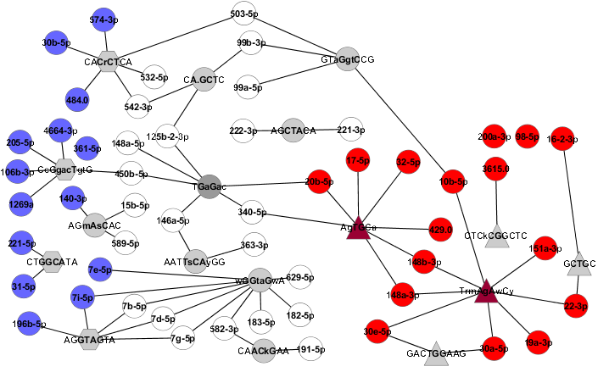

Slide 9
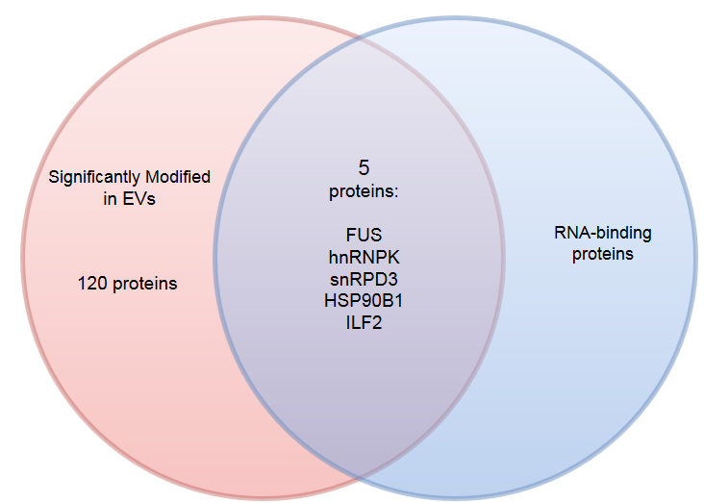
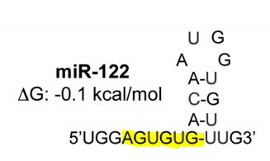
Proteins correlate to differential export.
5 Proteins with RNA binding ability in EVs.
hnRNPK binds to miRNAs.
hnRNP family linked to miRNA subcellular localization and export.

Slide 10
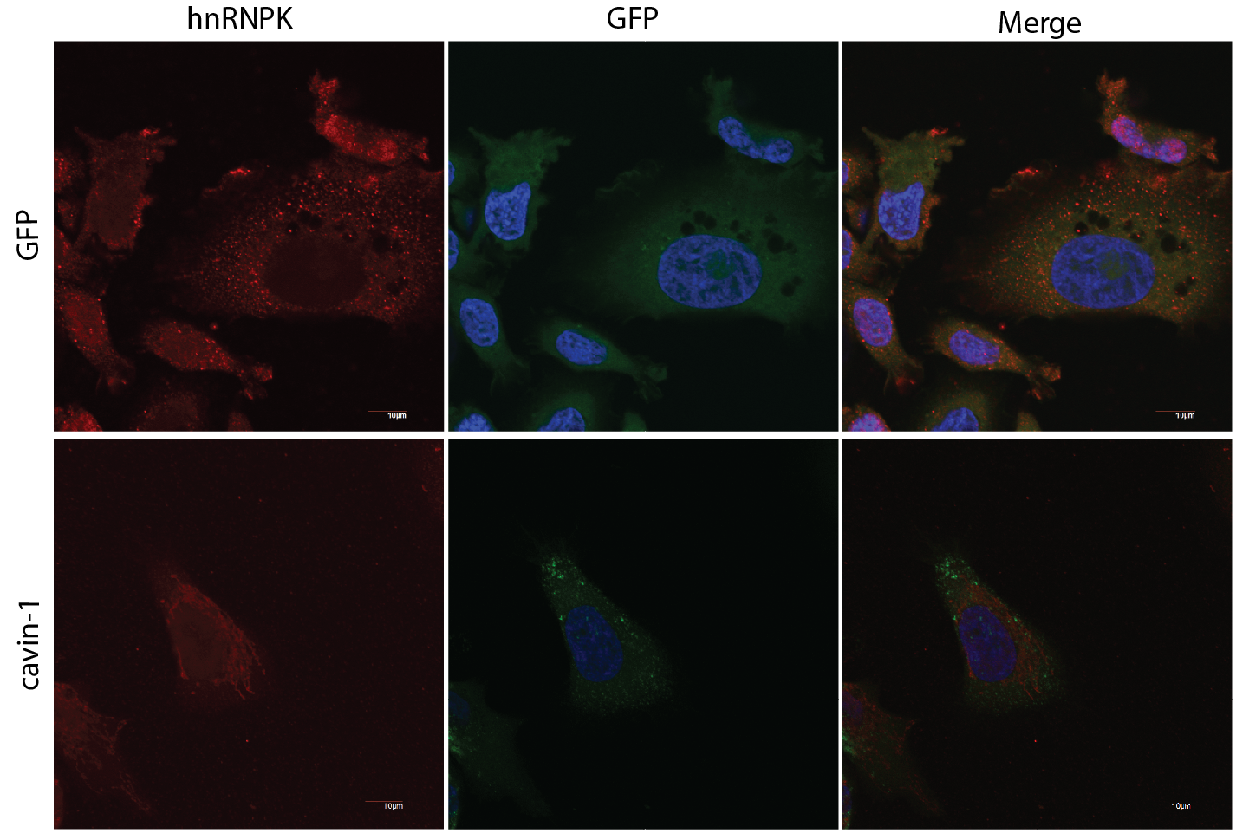
hnRNPK changes localization in cavin-1 cells:

Slide 11
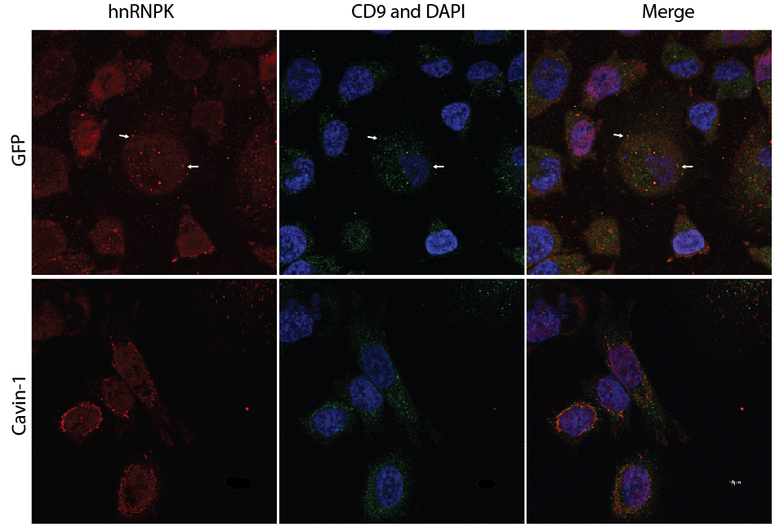
hnRNPK localizes to Multivesicular bodies.

Slide 12
To Do:
Confirm miRNA-Protein interaction via pull down/Western/MS
In vitro co-localization between protein and miRNA (using Cy5-oglio)

Slide 13
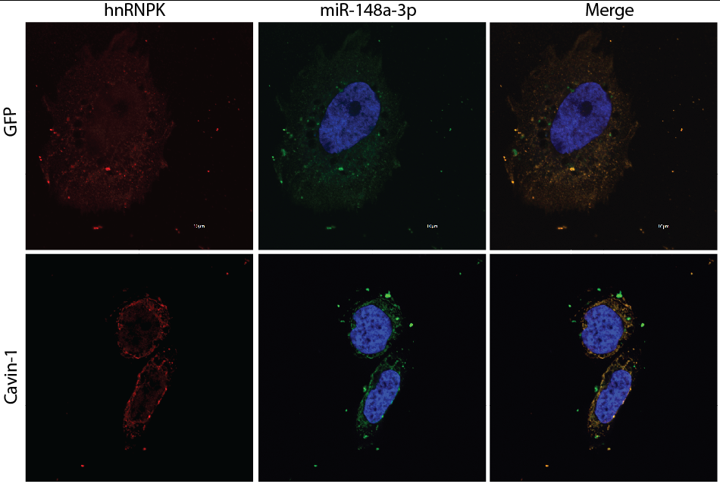
Beginning of MiR-hnRNPK co-localization.
Also completed for miR: 363,
30a (cavin-1 only) and 200a.

Slide 14
